Slide 1
Workforce Innovation and Opportunity Act (WIOA)
The Workforce Innovation and Opportunity Act (WIOA) is a federally funded program that establishes the Workforce Development System.
This funding is to support training and employment services for adults, dislocated workers, and low-income, out-of-school youth.
The Idaho Workforce Development Council acts as the workforce board for the state of Idaho.

Slide 2
WIOA Services
Eligible adults and dislocated workers can receive basic career services, individualized career services, and training to get jobs.
Out of school youth can get tutoring, mentorship, and other assistance to complete secondary-level education and connect to career training opportunities.
Financial assistance is available to employers to help train workers, create on-the-job-training opportunities and support laid off workers or those in need of other short-term services that help employees stay on the job.

Slide 3
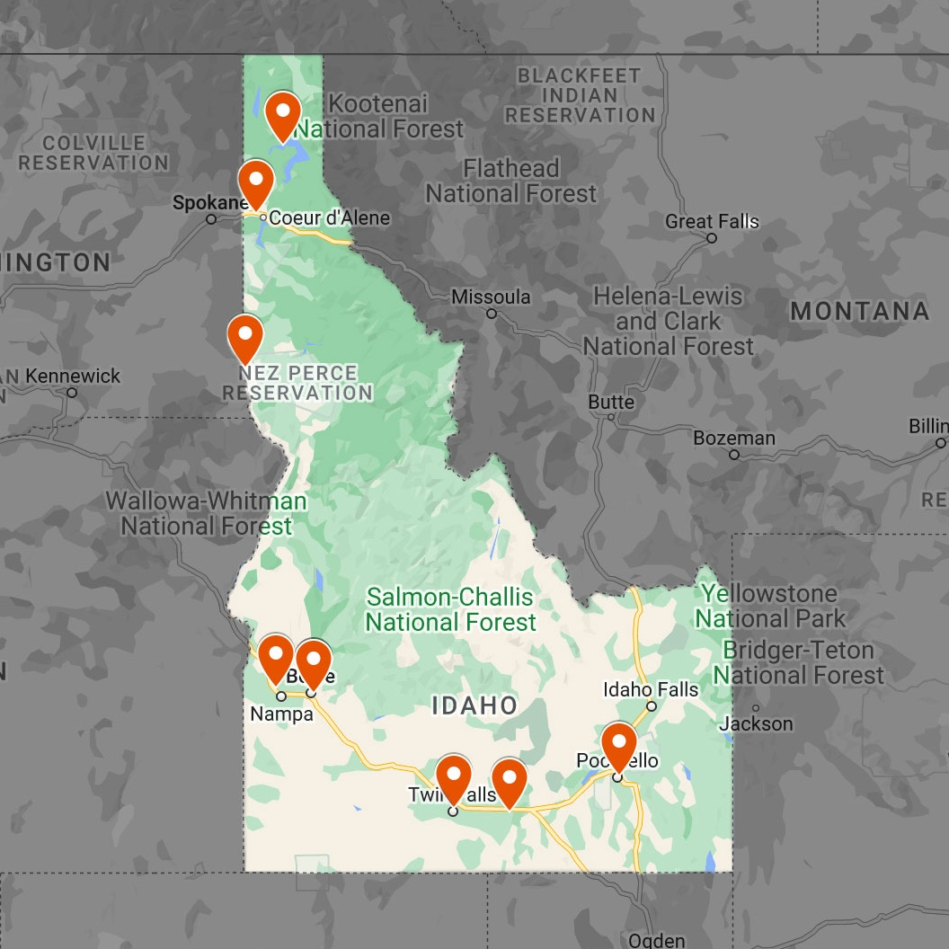
For More Information
Customers can access the full range of WIOA services through the American Job Centers located in each of the six geographic regions of the state.
Training providers need to be added to the Eligible Training Provider List before WIOA funds can be used to pay for occupational training.
Access information and connect to services at: https://wdc.app.s360.is/workforce-innovation-opportunity-act/
< image placeholder >

