Slide 1


Agency
Overview

Slide 2
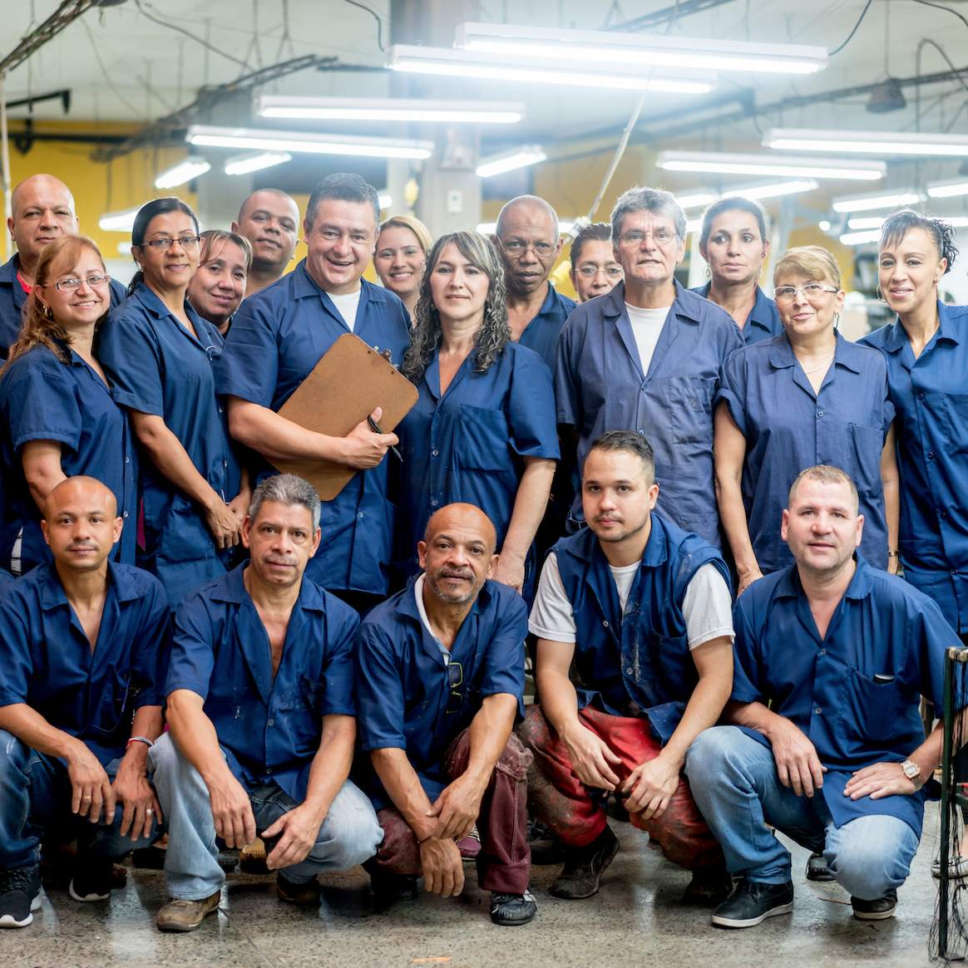
We make sure Idaho works.
Through its committees, programs, and collaborations the Idaho Workforce Development Council help connect Idahoans to career opportunities, and Idaho’s employers to a qualified workforce.
VISION
We envision a future where Idaho’s diverse and prepared workforce meets the needs of our unique communities and employers.
MISSION
We champion strategies that prepare Idahoans for careers that meet employers' needs.

Slide 3

Who We Are
Established in 2017, the Council is made up of 37 Governor appointed members from throughout the state:
17 Idaho employers
10 state government representatives
7 workforce representatives
A member from each chamber of the legislature, and a representative of the Governor.
Represented industry sectors include Healthcare, Construction, Technology, Aerospace, Energy, Finance, Professional Services, and Advanced Manufacturing. The Council also serves as the State Workforce Development Board.

Slide 4

What We Do
The Council’s work is focused on three strategic goals:
Goal #1 - Increasing the public awareness of and access to career education and training opportunities.
Goal #2 - Improving the effectiveness, quality, and coordination of programs and services designed to maintain a highly skilled workforce.
Goal #3 - Providing for the most efficient use of federal, state, and local workforce development resources.

Slide 5
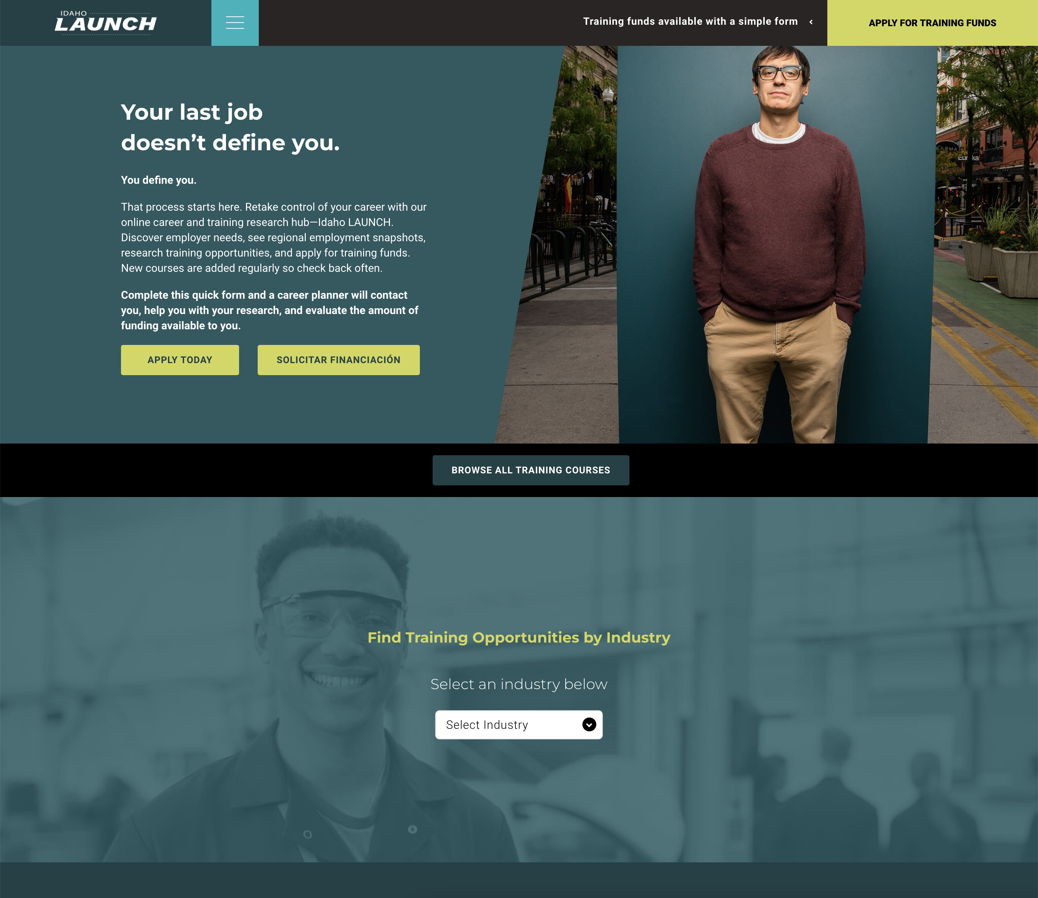
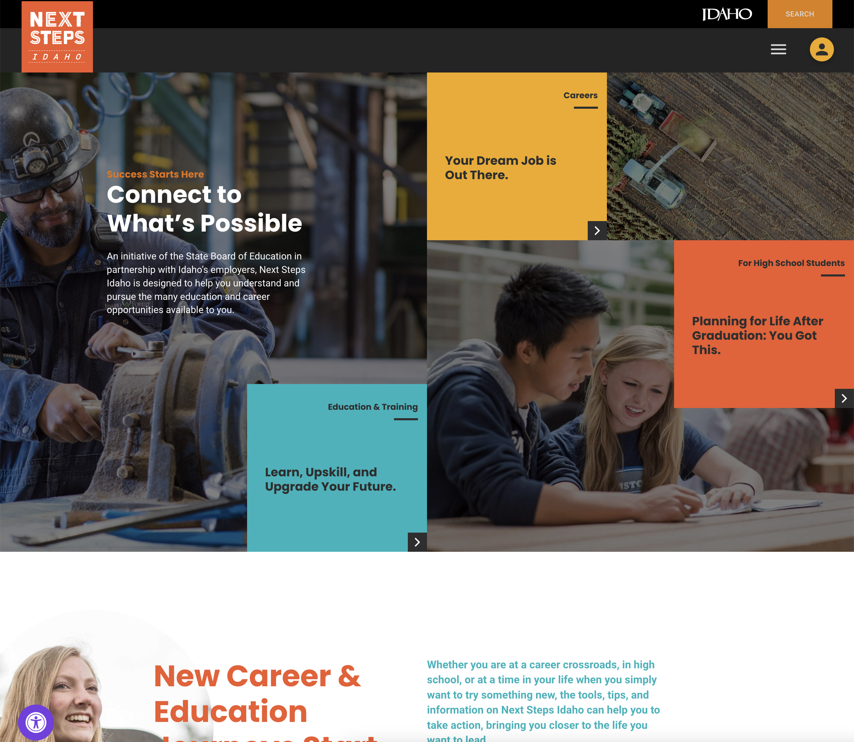
Featured Projects: Goals 1 & 3
Idaho Launch
idaholaunch.com
Next Steps Idaho Website
https://nextsteps.idaho.gov/
Notes:
Goal 1: Providing for the most efficient use of federal, state, and local workforce development resources. All of the WDC’s projects strive for the most efficient use of resources.
Goal 3: Improving the effectiveness, quality, and coordination of programs and services designed to maintain a highly skilled workforce.
Next Steps Idaho
An initiative of the State Board of Education in partnership with the Idaho Workforce Development Council, Next Steps Idaho is designed to help all Idahoans understand and pursue the many education and career opportunities available to them.
More than 1.1 million pageviews since 2021
Users spend an average of more than 5 minutes on the site per visit
Idaho Launch
This program offers statewide data about hiring trends and addresses the skills gap by empowering individual job seekers to directly access funded training opportunities to equip them with the skills and knowledge being sought by employers in every region of the state.

Slide 6

Featured Projects: Goals 1 & 2
Workforce Innovation and Opportunity Act
Grant Opportunities
Talent Pipeline Management Initiative
Youth Apprenticeship Readiness Grant
Idaho Leader
Notes:
Goal 1: Providing for the most efficient use of federal, state, and local workforce development resources. All of the WDC’s projects strive for the most efficient use of resources.
Goal 2: Increasing the public awareness of and access to career education and training opportunities.
Workforce Innovation and Opportunity Act (WIOA)
With this federally funded program—which establishes the Workforce Development System and provides funding to support training and employment services for adults, dislocated workers, and low-income, out-of-school youth—the Council applies its collective wisdom, experience, research, and local insights to help maximize the impact of these funds, in response to dynamic workforce needs.
Grant Opportunities
Utilizing state, federal, and private funds, the Workforce Development Council funds employer, industry, and public sector projects that increase the economic mobility of Idahoans, support growth of the economy, and develop Idaho’s workforce pipeline through training initiatives that serve multiple employers and industries.
Talent Pipeline Management Initiative
The Talent Pipeline Management Initiative (TPM), created by the U.S. Chamber of Commerce Foundation, uses a tested employer-led methodology to overcome industry specific skills gap challenges and helps employers save time, money and get the talent they need. Through TPM employers take the lead in building scalable, sustainable pipelines of talent. Cohorts are up and running in every region of Idaho.
Youth Apprenticeship Readiness Grant
Through a joint effort with the Idaho Workforce Development Council, Idaho Department of Labor, and Idaho Career and Technical Education, Idaho business for Education is scaling up Idaho’s Youth Apprenticeship program, with a goal of placing 400 apprentices by 2024 in some of the 1,200 federal apprenticeships.
LEADER Initiative
Sensing a gap in making critical workforce-readiness connections, the Council created this initiative, designed to help employers and education entities scale work-based learning opportunities through programs such as internships, externships, apprenticeships, co-ops, career education, and on-the-job training.

Slide 7

wdc.idaho.gov

