Slide 1
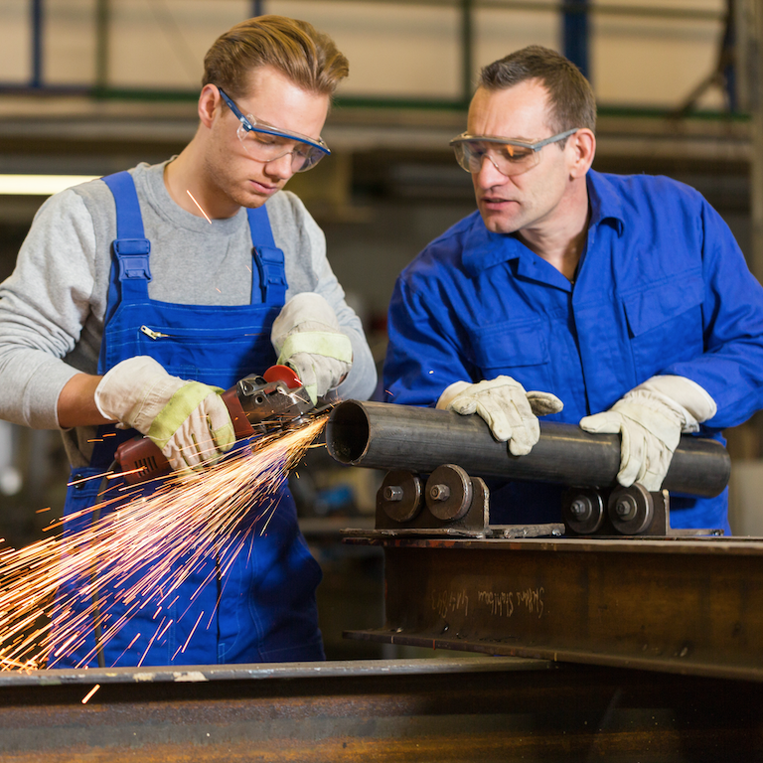
Idaho Talent Pipeline Management Initiative
Led by the Idaho Workforce Development Council, TPMⓇ is designed to be a scalable, employer-led solution designed to close the skills gap in ways that generates shared value and a return on investment (ROI) for employers as well as learners, education and workforce providers (including OPSOs), and the communities in which they reside.

Slide 2
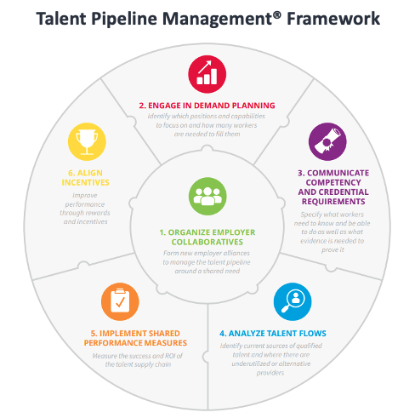
Idaho Talent Pipeline Management Initiative

Slide 3
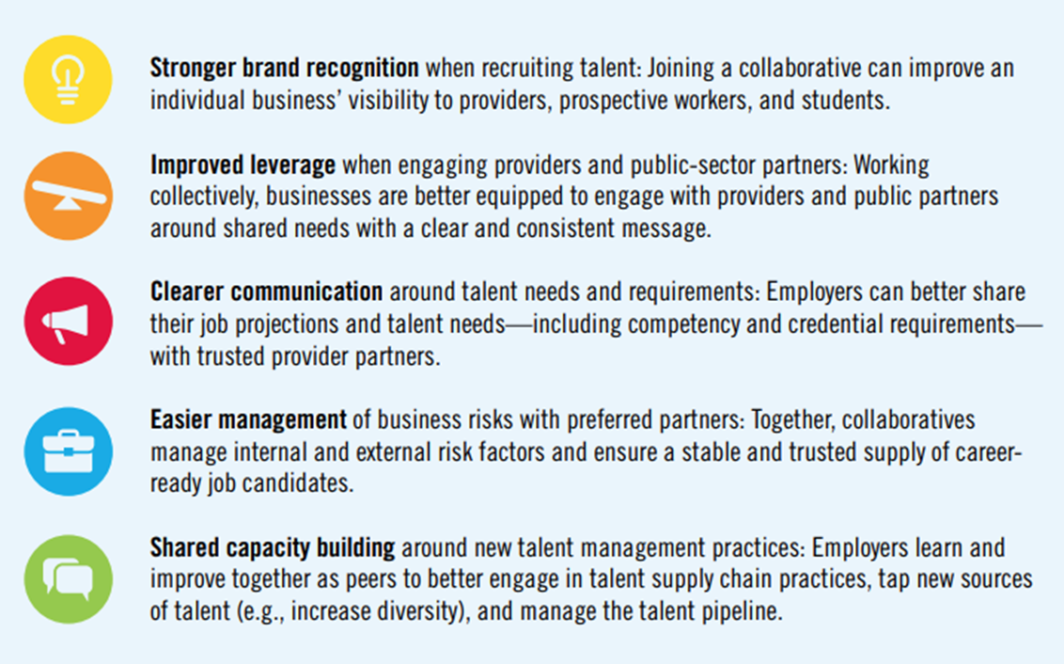
Grant Eligibility & Deadlines
Employers can support Idaho’s implementation of TPM by working with regional project managers to start or participate in industry-specific collaborative designed to address workforce pipeline issues.

Slide 4
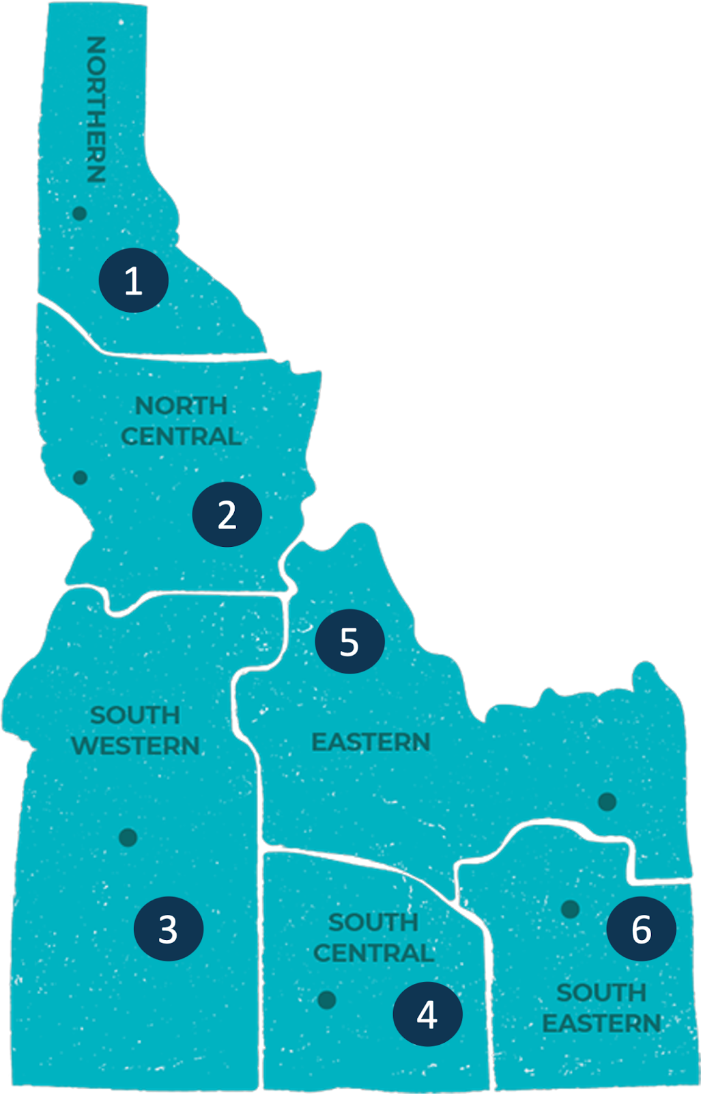
Idaho Talent Pipeline Management Initiative
Regional Industry Efforts
NORTHERN - Hosted by Coeur d’Alene Area Economic Development: Healthcare & Construction
NORTH CENTRAL - Hosted by Clearwater Economic Development Assn: Healthcare & Natural Resources
SOUTHWESTERN - Hosted by 1 Percent Consulting: Construction, Healthcare, Broadband
SOUTH CENTRAL - Hosted by College of Southern Idaho: Food Processing & Healthcare
EASTERN and SOUTHEASTERN - Hosted by College of Eastern Idaho
STATEWIDE - Hosted by Idaho Associated General Contractors: Construction
STATEWIDE - Hosted by Idaho Manufacturing Alliance: Advanced Manufacturing

