Slide 1
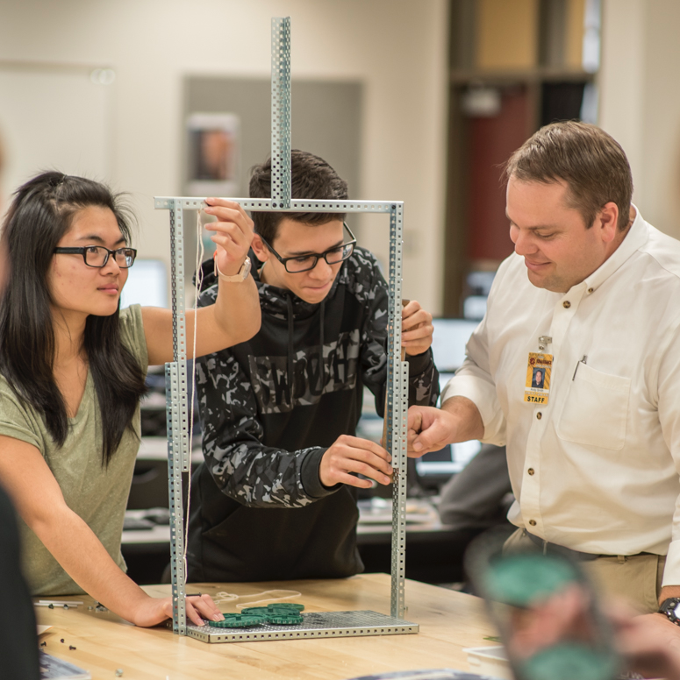
Youth Apprenticeship Readiness Grant
In 2020, the Idaho Workforce Development Council received a Youth Apprenticeship Readiness Grant to develop 400 Registered Apprenticeships for Idaho youth between the ages of 16-24, one of just 14 projects nationwide.
The Idaho Youth Apprenticeship Project is wholly funded by a grant from the U.S. Department of Labor in the amount of $2,490,630.

Slide 2
Youth Apprenticeship Readiness Grant
Through a grant from, and in partnership with, the Idaho Workforce Development Council, Idaho Business for Education (IBE) has been charged with developing a statewide system to support youth apprenticeship programs. Regional staff are helping employers and educators start Registered Apprenticeships in their communities, connecting employers to talent, and connecting youth with apprenticeship opportunities.
Idaho Business for Education (IBE) was chosen to lead this project because of their access to both employers and the education system. Their membership is made up of nearly 250 business leaders from across the state.
As part of this effort, IBE also collaborates closely with the Apprenticeship Idaho Coalition as it works to bolster Idaho’s apprenticeship system.

Slide 3
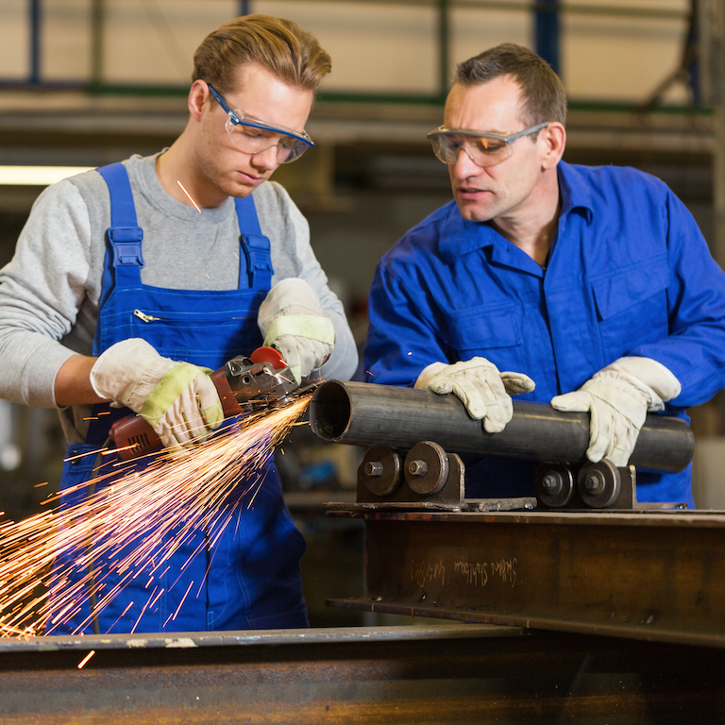
Youth Apprenticeship Readiness Grant
Why Youth Apprenticeship Programs?
1
Youth Apprenticeships provide access to an under-served labor pool
Employees are loyal to employers who invest in their skills and professional development
Apprenticeships provide another pathway for students to “go-on” to additional training after high school, one that includes real-world experience and leads to a recognized and marketable credential
2
3

Slide 4
Youth Apprenticeship Readiness Grant
If you would like to learn more or see open Youth Apprenticeship Opportunities visit:
idahoyouthapprenticeship.org/
If you are interested in starting a Youth Apprenticeship, contact your Regional Youth Apprenticeship Coordinator:
NORTH IDAHO
Christina Feliciano
cfeliciano@idahobe.org
(208) 502-0070
EASTERN IDAHO
Roger Plothow
rplothow@idahobe.org
(208) 317-7791
SOUTHWEST IDAHO
Tim Blonsky
tblonsky@idahobe.org
(208) 918-4705
SOUTH CENTRAL IDAHO
Angie LeBlanc
aleblanc@idahobe.org
(208) 534-8255

