Slide 1
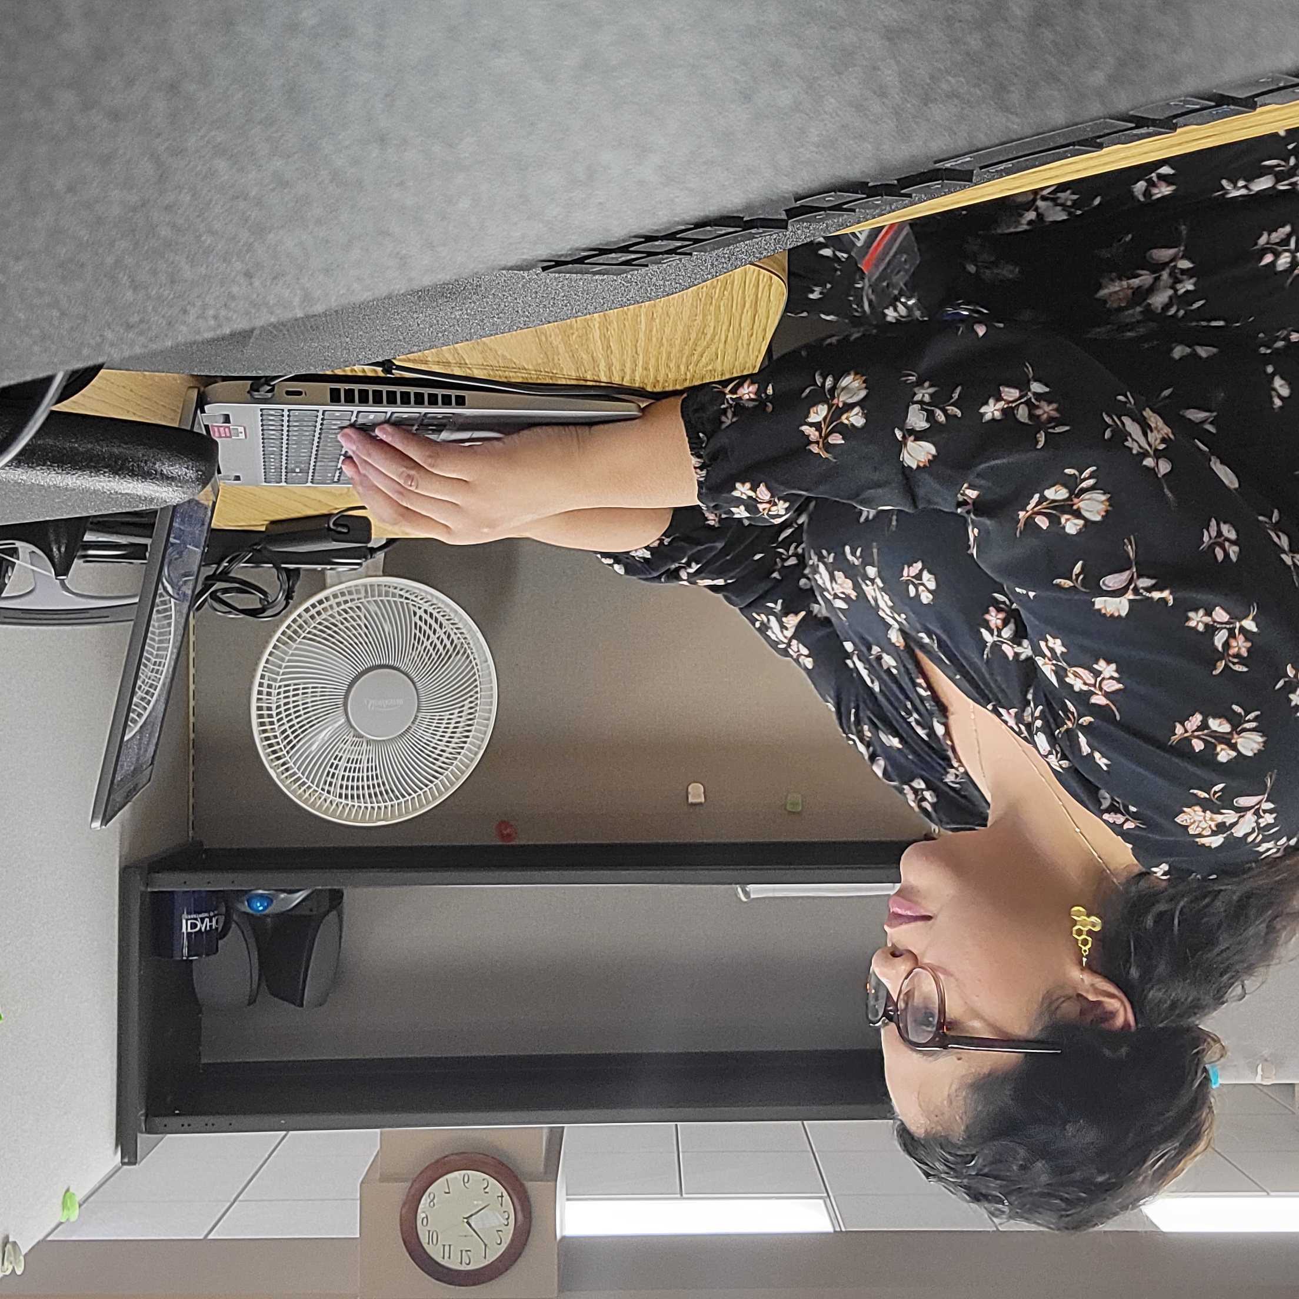
Teacher Externship Program
Every summer, the STEM Action Center, in partnership with the Workforce Development Council, provides K-12 classroom teachers and college and career advisors the opportunity to work at an Idaho employer where they gain valuable experience in an industry beyond education, helping them better prepare students for the world of work.
< image placeholder >

Slide 2
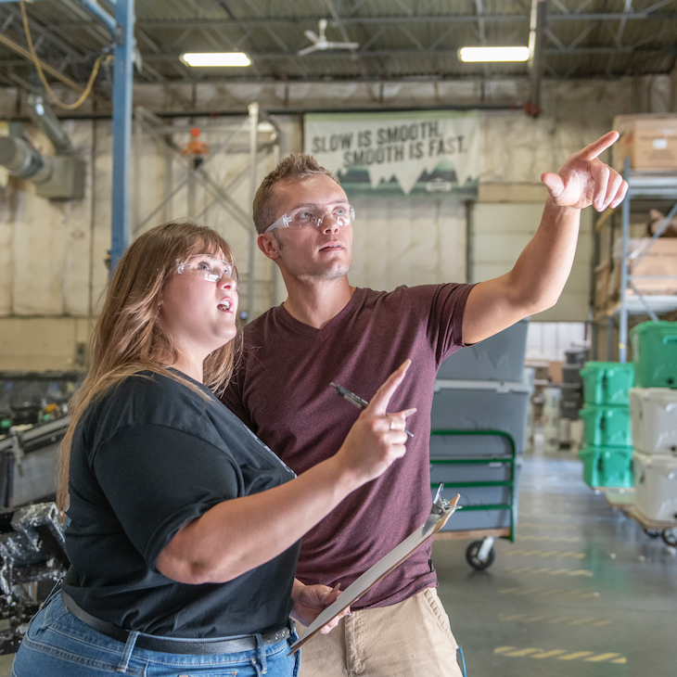
Teacher Externship Program
The program places externs with employers, leveraging their area of certification, and requires them to complete 200 hours of on-site, experiential learning.
Participants earn $5,000 and professional development credit.

Slide 3
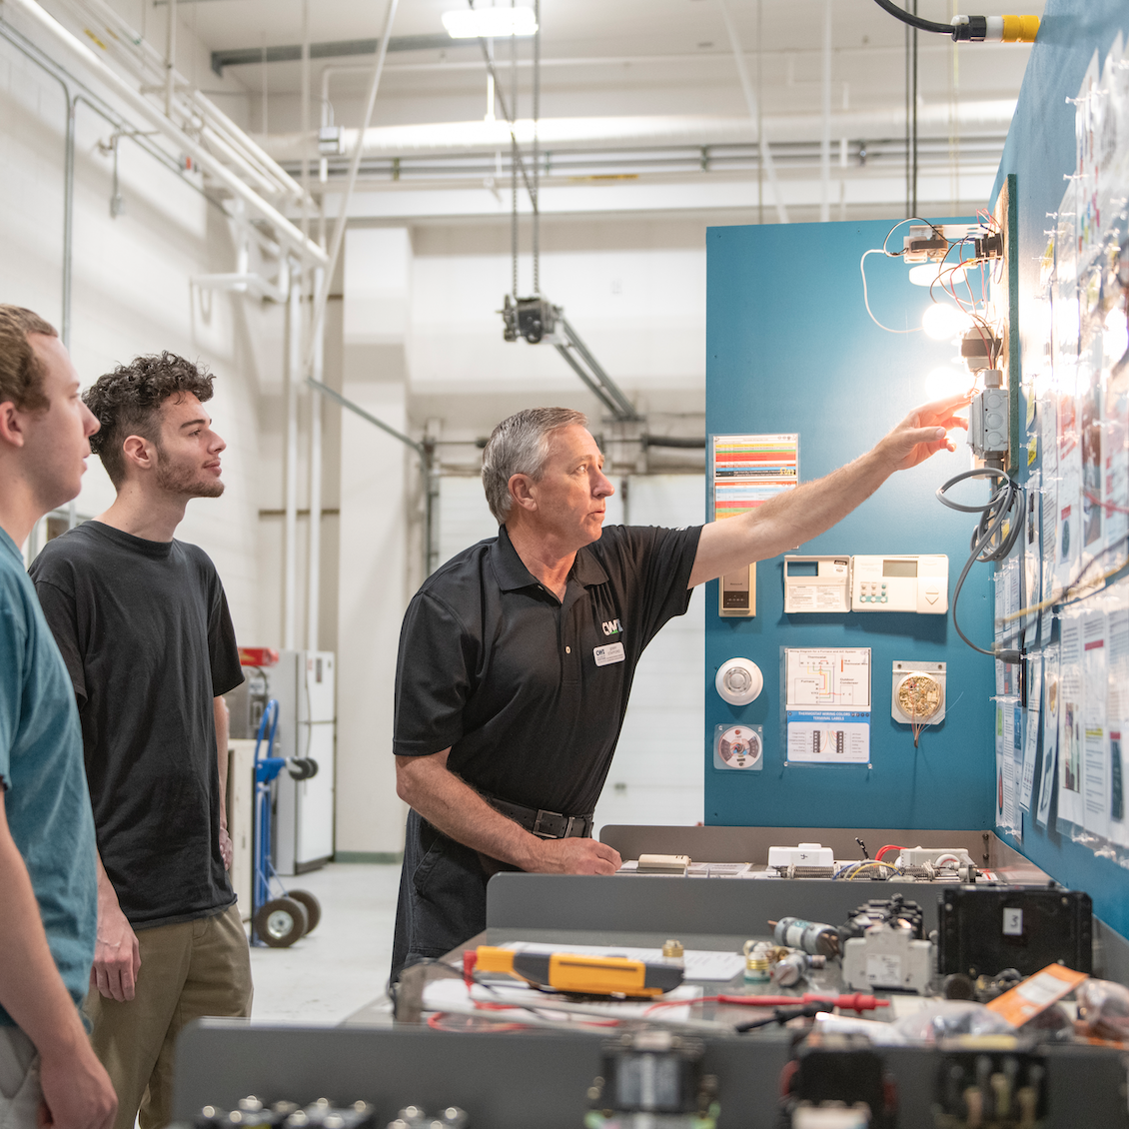
Teacher Externship Program
Expectations of Participating Businesses
Provide a challenging work opportunity that contributes to company operations while providing authentic workplace experiences
Ensure educator sees broader career opportunities within the organization/industry and understands challenges of hiring and retaining employees
Provide the necessary training and ongoing mentoring needed for the extern to be successful
If possible, contribute to the stipend that will be paid to the extern

Slide 4
Teacher Externship Program
Expectations of Educators
Be a certified Idaho K12 public school teacher or a college and career advisor working in an Idaho public school and planning to return following summer break
Submit an application through the STEM AC and meet prospective employer(s) for interviews
Be able to work 200 hours over the summer and meet performance expectations
Share experiences with other educators and college and career advisors regionally

Slide 5
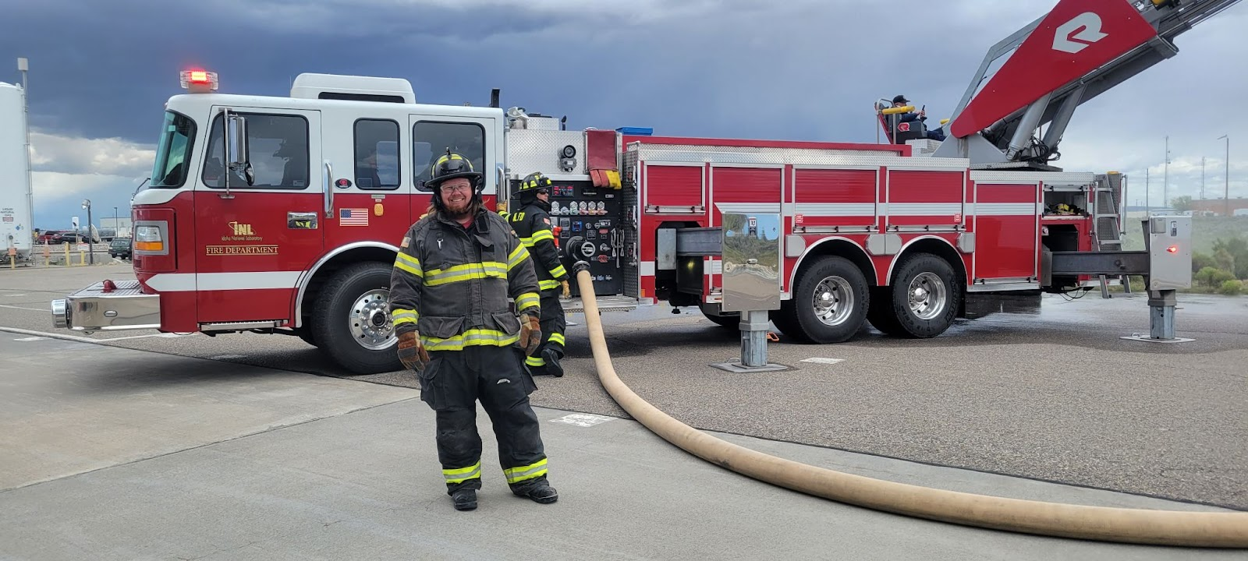
Teacher Externship Program: Extern Stories 2022
I was invited to participate as an intern/mentor in an INL externship for high school students. This externship is for local CTE students to learn about the crafts and trades that are done at the INL. For six weeks we went on field trips or tours to different locations of INL to visit with the professionals at those locations.
They would teach us about their jobs and let us get some hands-on experience with the work or training they were doing. It was awesome to hear their first-hand experiences of where they came from and how they got to the job they were at.
It helped me to see the relevance of trades and trade technology in the workforce today and the best route to get into these careers.
Trevor Shepherd
Idaho National Laboratory

Slide 6
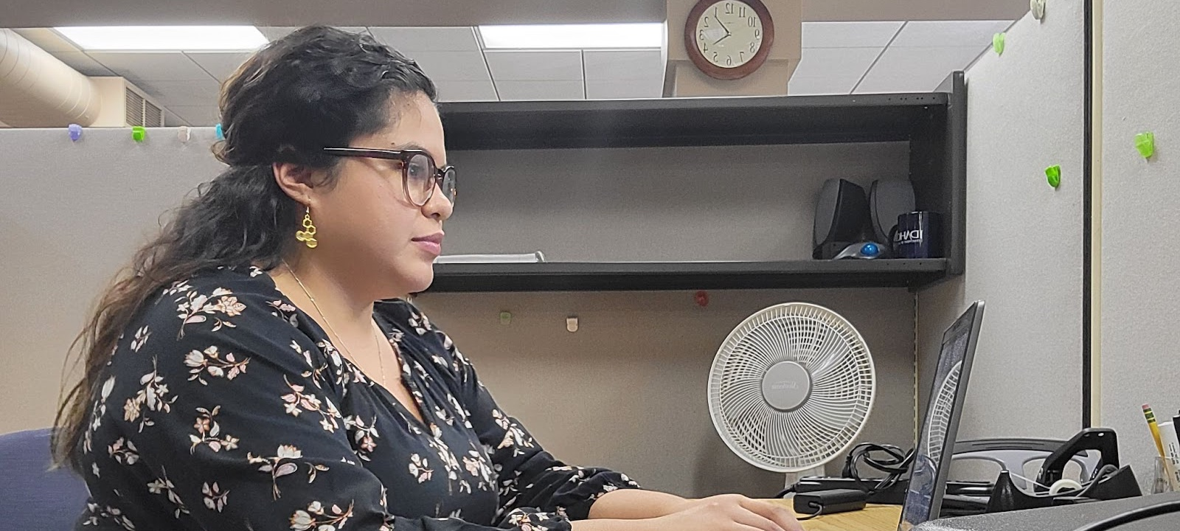
Teacher Externship Program: Extern Stories 2022
This summer I had the opportunity to work with IDOL’s Apprenticeship Idaho team. During my 5-week externship, I translated handouts, collected school district data, collaborated with organizations throughout Idaho, and much more!
What I’m most proud of during my time is helping edit and revise a children’s book on apprenticeships that will be distributed to elementary schools throughout the state. It’s been an honor to be a small part of this project! I can’t believe my work will be read and used by hundreds, if not thousands of students!
What I value most about my experience, are my amazing coworkers and supervisor. They welcomed me with open arms and warm hearts. I’ve felt appreciated, valued, and trusted from day one. It’s been amazing!
Jessica Garcia Gonzalez
Idaho Department of Labor

Slide 7
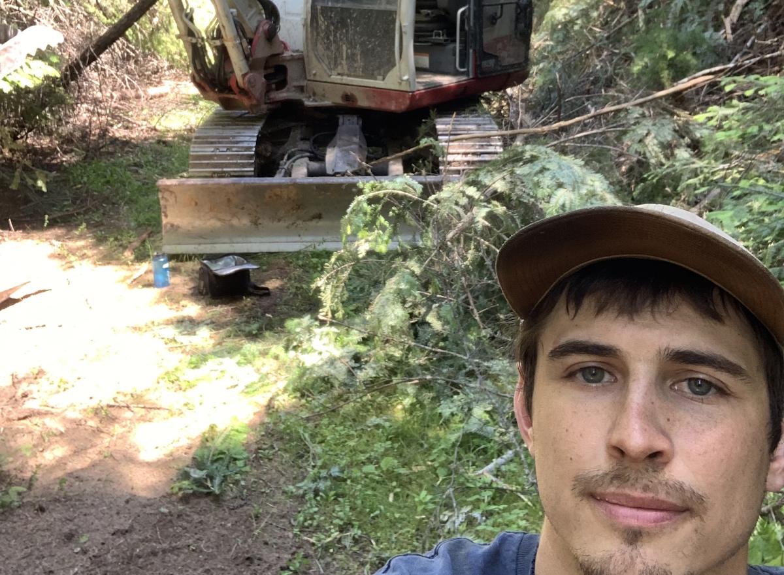
Teacher Externship Program: Extern Stories 2022
This is the second summer that I had the privilege to work for Triple B Excavation through the STEM Action Center. This experience has allowed me to take the knowledge gained from the previous summer and apply it to my math classroom in a way that greatly benefited my students.
Due to the highly active fire season, we experienced in 2021 the students were highly interested and engaged in this topic.
Because of this externship I was able to make connections between wildland fires and math for my students.
Landon Gossak
Triple B Excavation

